Slide 1
Craft Beers and Breweries
Nicole Norelli
Allen Miller

Slide 2
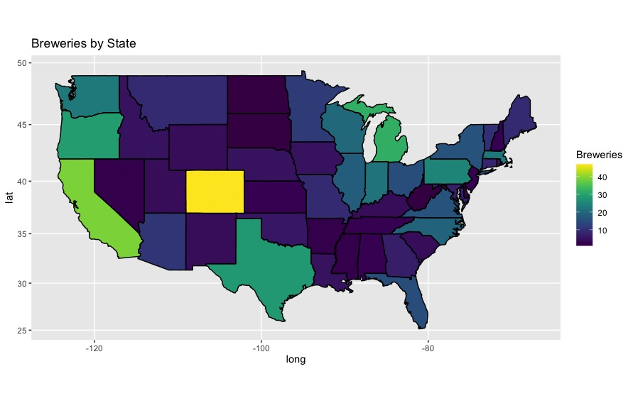
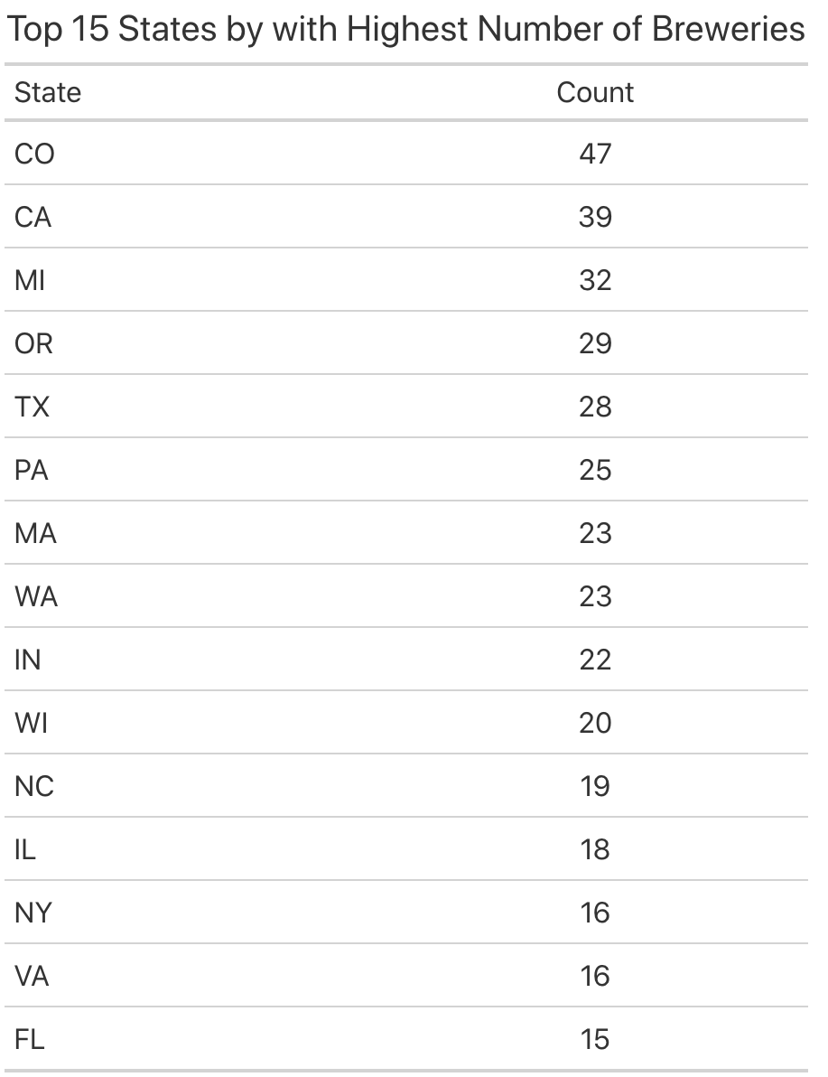
Number of Breweries in each State

Slide 3
Missing Values
Problem:
ABV missing 62 values (2.6%)
IBU missing 1005 values (41.7%)
Resolution:
Omit for statistical analysis
Impute IBU values to improve machine learning classification

Slide 4
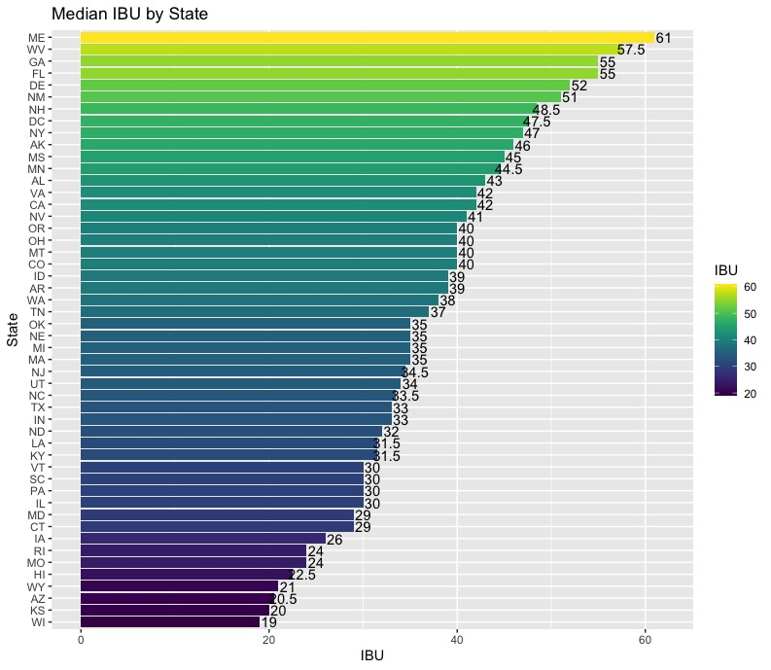
Median IBU by State
There doesn’t appear to be an obvious correlation between a state and its median IBU level
Note: South Dakota was removed due to not having reported any values for IBU

Slide 5
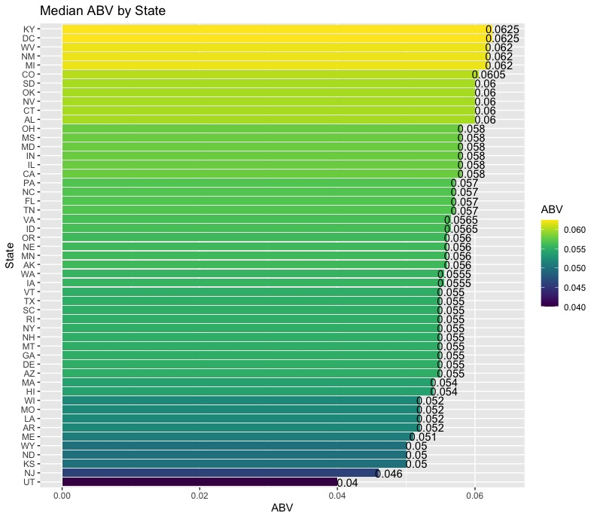
Median ABV by State
West Virginia
12% ABV cap on beer
Utah
5% ABV cap on beer sold in Liquor stores (raised in 2019 from 4%)
4% ABV cap on all other beer sales

Slide 6
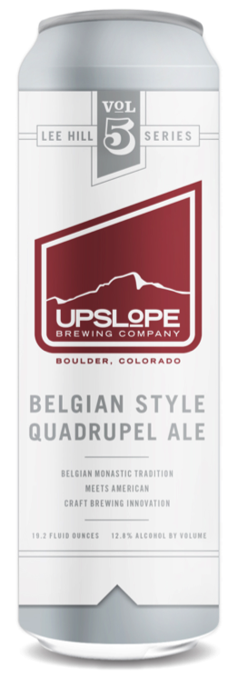
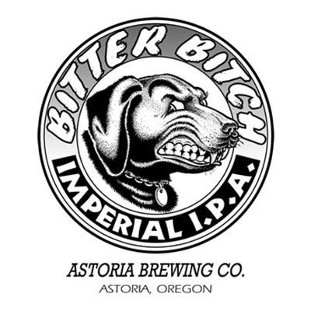
Highest ABV and IBU
Colorado has the beer with the highest ABV
Name of Beer: Lee Hill Series Vol. 5 - Belgian Style Quadrupel Ale
Brewed By: Upslope Brewing Company
ABV: 0.128
Oregon has the beer with the highest IBU
Name of Beer: Bitter Bitch Imperial IPA
Brewed By: Astoria Brewing Company
IBU: 138

Slide 7
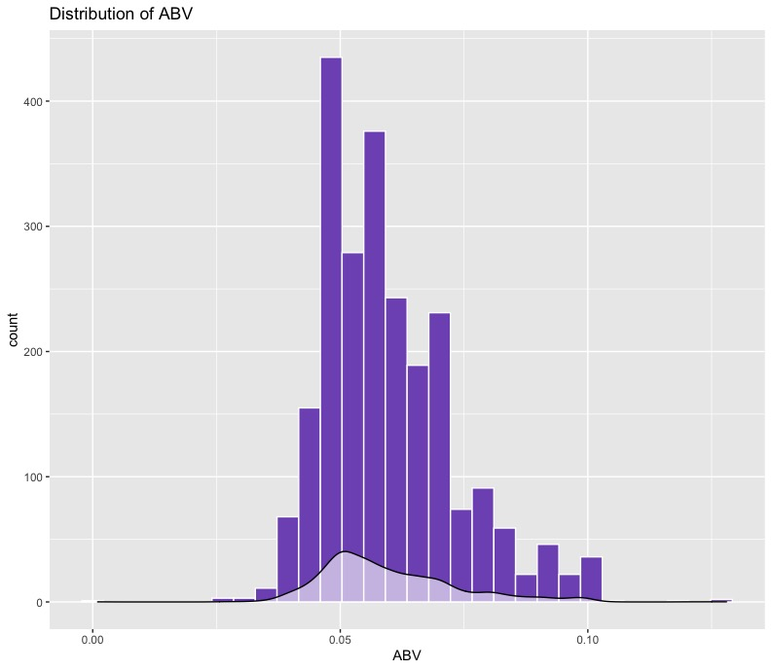
Alcohol Content
Median is centered around 0.05 ABV
Slightly right-skewed distribution
Summary Statistics:
Minimum: 0.001
Median: 0.056
Max: 0.128
Standard Deviation: 0.0135

Slide 8
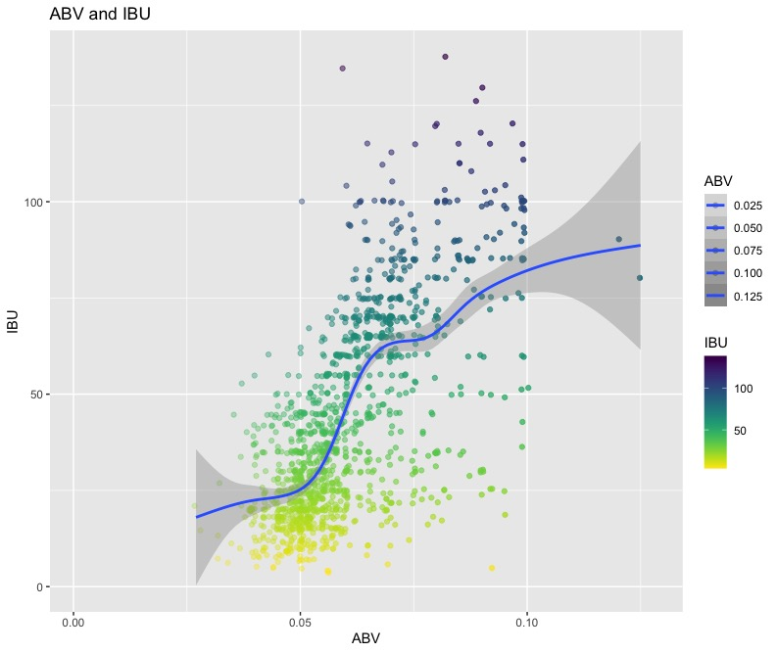
Relationship between ABV and IBU
Possible explanation: Brewing 101
Higher IBU = more hops
More hops = more bitter
To balance bitter = more malt (sugar)
More sugar + yeast = higher ABV

Slide 9
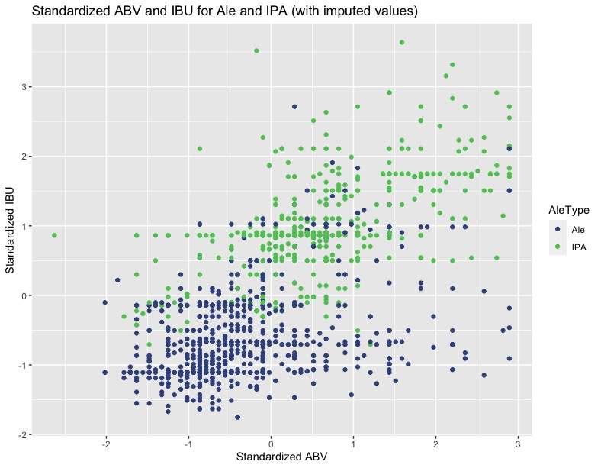
Using Machine Learning to Classify Beer Style
Predicts Ale or IPA using IBU and ABV
Accuracy: 89.74%
Sensitivity: 91.62%
Correct ID of Ale
Specificity: 86.61%
Correct ID of IPA
Missing IBU values imputed with median IBU by style
Nearly a 3% increase in accuracy

Slide 10
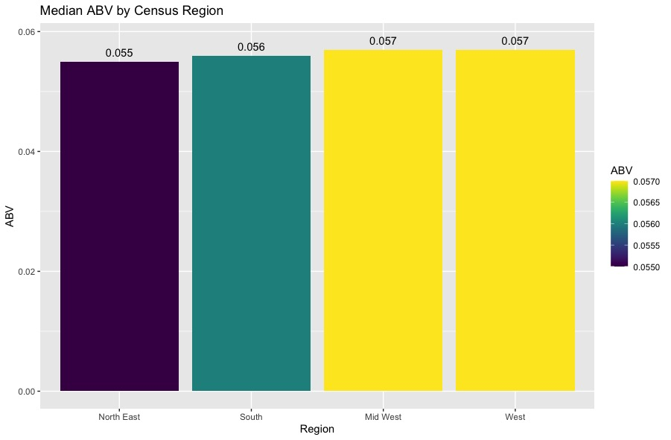
Median ABV Level by Census Region
Little difference on ABV level based on census region
This makes sense because there was little variation in the median ABV level of all states

Slide 11
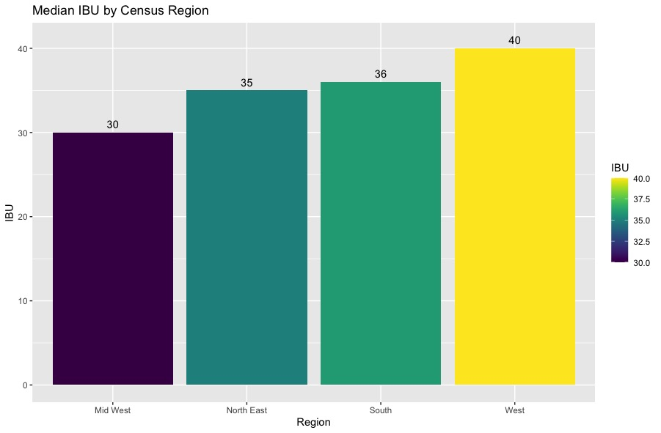
Median IBU Level By Census Region
Craft Beers in Western States tend to have a higher median IBU level
Oregon is part of the west and had the beer with the highest IBU level.

Slide 12
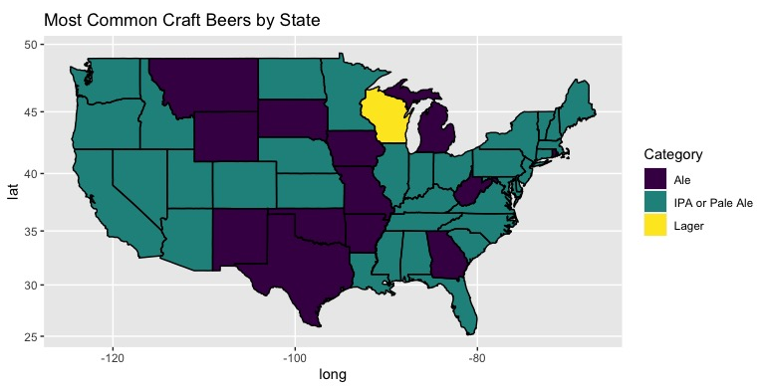
Most Common Beer Style by State
IPA is the most common craft beer type throughout in 37 states and District of Columbia.
13 States had Ale as the most common type of craft beer produced.
Only one state (WI) had a type of beer other than Ale or IPA as the most common beer type in production.

Slide 13
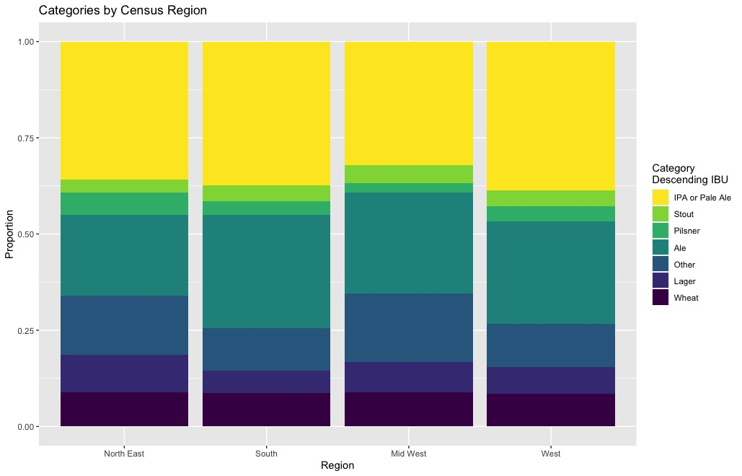
Popularity of beer styles by Census Regions
Similar proportions
IPA & Ale most common in all regions
Market for IPA/Pale Ale throughout U.S.

Slide 14

Questions or Comments?

